Slide 1
Global Jobs & Salaries
CS131 Class Project 2
Ron Ly
Gursimran Kaur
Chih-Kuo Hsu
Sheel Patel

Slide 2
Project Objectives
Highest & Lowest Paying Jobs in each Country
Jobs that are globally valued/unvalued
Job Markets that globally have the highest salaries
Categories with variety of jobs
Availability/Variety of Job Roles/Titles
Average Salary Range of these Jobs
Currency Exchange Rate
Strong/weak economy stability of each country
High/low inflation rates

Slide 3
Dataset Metadata
Data Set
Countries
Salary/Currency
Jobs
“Global Jobs and Salaries 2024”
Entries: 3628
206 Countries
Currency
Salary
Exchange Rate
Salary (USD)
Category
Job Sectors

Slide 4
Job Availability & Average Salary (US)
Health and Medical
Information Technology
Accounting and Finance
Teaching / Education
Engineering
Executive and Management
Banking
Human Resources
Science and Technical Services
Food / Hospitality / Tourism / Catering
$61,286.3
#375
$41,226.2
#304
Average Salary
$42,203.1
#190
$43,530.1
#183
$34,643.2
#172
Unique Job Titles/Roles
$55,522.1
#148
$44,607.9
#123
$38,844
#114
$54,970.8
#111
$27,456.4
#109

Slide 5
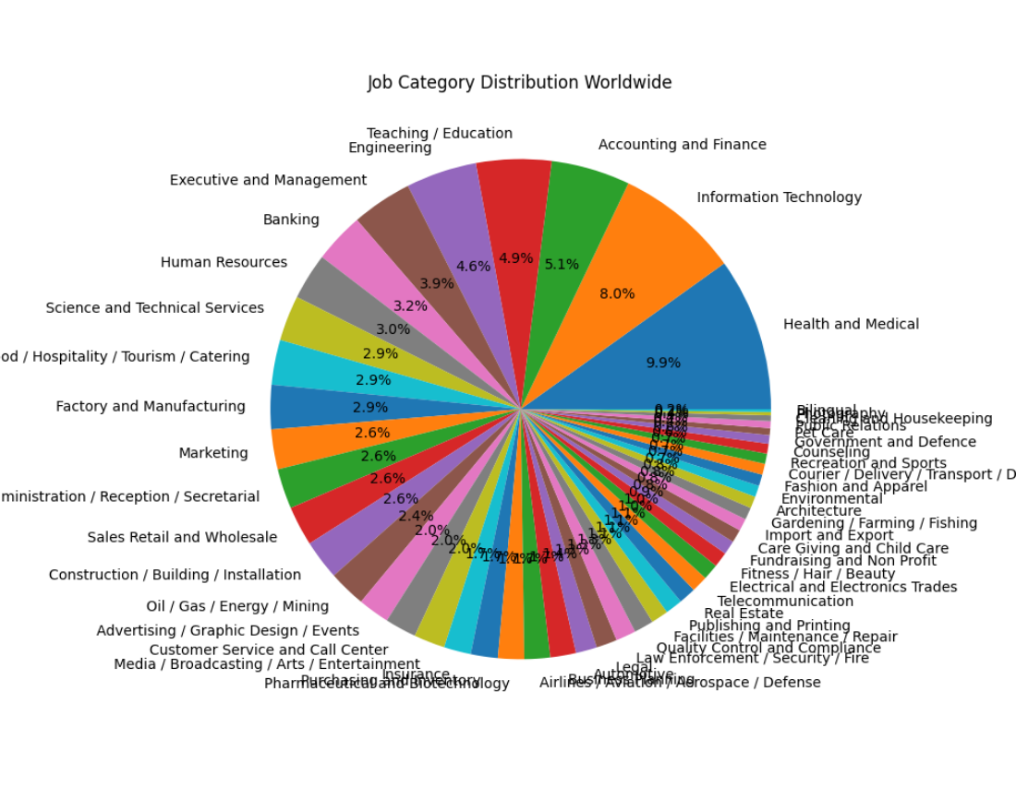
Job Category Distribution
3 Highest Paying Jobs Globally
Heart Transplant Surgeons - Medical and Health(~180K-200K)
Magistrate Judge, Legal(~$80K-90K)
Pharmaceutical Manufacturing, Pharmaceutical and Biotechnology (~50K-60K)

Slide 6
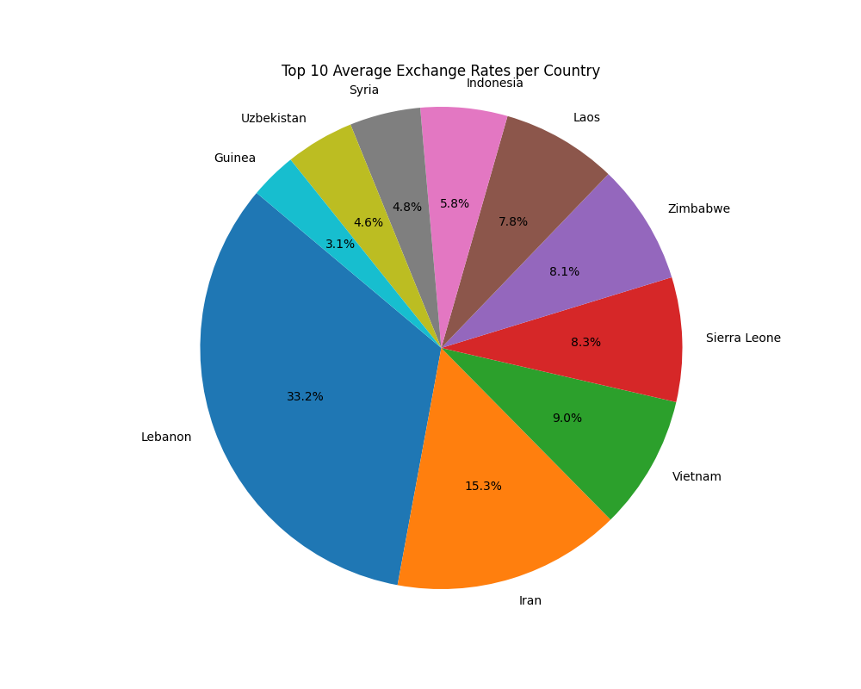
Exchange Rates per Country
3 Highest Exchange Rates Globally
Lebanon(39.2%) - 90,879.93 LBP/ $1 USD
Iran(15.3%) - 41,854.62 IRR/ $1 USD
Vietnam(9%) - 24,640.60 VND/ $1 USD

Slide 7
Conclusion
Global Salary Disparities: Significant wage gaps between developed and economically challenged countries.
Job Diversity: Focused on categories with unique job titles to highlight different sectors with diverse job roles.
Economic Insights: Analyzed average salaries in diverse job sectors, reflecting global labor market dynamics.
Notes:
conclusion script:
In our global salary analysis, we observed significant disparities in average salaries across different countries. Developed countries such as Switzerland, the United States, the United Kingdom, Canada, and Belgium tend to offer higher wages. Conversely, countries like Zimbabwe, Syria, Lebanon, Palestine, and Argentina face economic challenges, reflected in their considerably lower average salaries. Additionally, we focused on exploring job categories with the most unique job titles to identify sectors with a diverse set of jobs. By calculating the average salaries within these categories, we gained insights into the economic value of diverse job roles across the global labor market.

Slide 8
Commands Used:
Dataset metadata: head -n 1 'global_jobs_salaries_2024 2.csv' | tr ',' '\n'
Number of Entries: wc -l 'global_jobs_salaries_2024 2.csv'
Highest Salary: awk -F ',' '{print $7}' global_jobs_salaries_2024.csv | sort -n -r | head -n 2
Lowest Salary: cut -d ',' -f 7 global_jobs_salaries_2024.csv | sort -n | head -n 2
Finding percentage of Job Category: awk -F ',' '$3 == "Health and Medical" { medical_count++ } { total_count++ } END { percentage = (medical_count / total_count) * 100; print "Percentage of Health and Medical Jobs:", percentage "%" }' global_jobs_salaries_2024.csv
Finding average salary of Job Category: awk -F ',' '$3 == "Banking"' global_jobs_salaries_2024.csv | awk -F ',' '{ sum += $7; count++ } END { if (count > 0) print "Average Salary:", sum/count; else print "No data found for Banking job category" }'
Finding top 10 job categories with most unique job titles: awk -F ',' '{print $3 "," $2}' global_jobs_salaries_2024.csv | sort -u | awk -F ',' '{print $1}' | sort | uniq -c | sort -nr | head -n 10

